Slide 1
Binary Data Encoding
Lecturer: Ngo Huy Bien
Software Engineering Department
Faculty of Information Technology
VNUHCM - University of Science
Ho Chi Minh City, Vietnam
nhbien@fit.hcmus.edu.vn

Slide 2

Objectives

Slide 3

Contents

Slide 4

References

Slide 5
The Sensor Data
https://medium.com/learning-the-go-programming-language/encoding-data-with-the-go-binary-package-42c7c0eb3e73
Imagine that you are writing Go code for small remote devices collecting sensor data to send to backend edge servers.
To save bandwidth (and other resources), you decide to create a simple binary format for your data as outline below:
0 1 2 3 4 5 6 7 0123456701234567012345670123456701234567012345670123456701234567 +-------+-------+-------+-------+-------+-------+-------+------+ | SensorID | LocationID | Timestamp | +-------+-------+-------+-------+-------+-------+-------+------+ | Temp | +---------------+

Slide 6
The Sensor Data Detail
0 1 2 3 4 5 6 7 0123456701234567012345670123456701234567012345670123456701234567 +-------+-------+-------+-------+-------+-------+-------+------+ | SensorID | LocationID | Timestamp | +-------+-------+-------+-------+-------+-------+-------+------+ | Temp | +---------------+
The data is arranged in a fixed-size binary packet of 80 bits that divided into four fields including
SensorID (16 bit),
LocationID (16 bit),
Timestamp (32 bit), and
Temperature (16 bit).

Slide 7
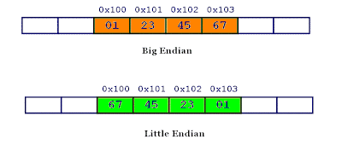
Little and Big Endian
https://www.geeksforgeeks.org/little-and-big-endian-mystery/
Little and big endian are two ways of storing multibyte data-types ( int, float, etc).
In little endian machines, last byte of binary representation of the multibyte data-type is stored first.
On the other hand, in big endian machines, first byte of binary representation of the multibyte data-type is stored first.
Suppose integer is stored as 4 bytes (For those who are using DOS-based compilers such as C++ 3.0, integer is 2 bytes) then a variable x with value 0x01234567 will be stored as following.

Slide 8
Use the BigEndian Type to Encode Data (I)
package main
import (
"encoding/binary"
"fmt"
"time"
)
/*
0 1 2 3 4 5 6 7
0123456701234567012345670123456701234567012345670123456701234567
+-------+-------+-------+-------+-------+-------+-------+------+
| SensorID | LocationID | Timestamp |
+-------+-------+-------+-------+-------+-------+-------+------+
| Temp |
+---------------+
*/

Slide 9
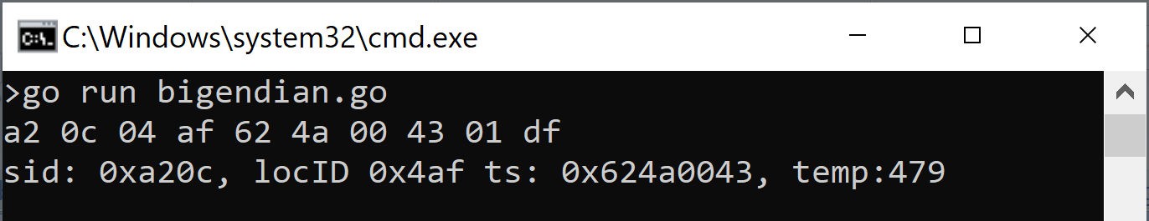
Use the BigEndian Type to Encode Data (II)
func main() {
buf := make([]byte, 10)
ts := uint32(time.Now().Unix())
// Encoding the data into buf
binary.BigEndian.PutUint16(buf[0:], 0xa20c) // sensorID
binary.BigEndian.PutUint16(buf[2:], 0x04af) // locationID
binary.BigEndian.PutUint32(buf[4:], ts) // timestamp
binary.BigEndian.PutUint16(buf[8:], 479) // temp
fmt.Printf("% x\n", buf)
// Decoding the data from buf
sensorID := binary.BigEndian.Uint16(buf[0:])
locID := binary.BigEndian.Uint16(buf[2:])
tstamp := binary.BigEndian.Uint32(buf[4:])
temp := binary.BigEndian.Uint16(buf[8:])
fmt.Printf("sid: %0#x, locID %0#x ts: %0#x, temp:%d\n",
sensorID, locID, tstamp, temp)
}

Slide 10
Use the binary.Write to Encode Data (I)
package main
import (
"bytes"
"encoding/binary"
"fmt"
)
type packet struct {
Sensid uint32
Locid uint16
Tstamp uint32
Temp int16
}

Slide 11
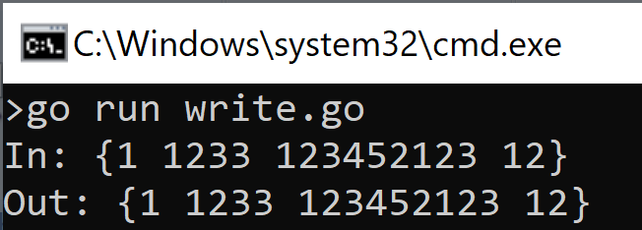
Use the binary.Write to Encode Data (II)
func main() {
dataIn := packet{Sensid: 1, Locid: 1233, Tstamp: 123452123, Temp: 12}
buf := new(bytes.Buffer)
// put single encoded data packet into writer buf
// automatically marshaled to type packet
if err := binary.Write(buf, binary.BigEndian, dataIn); err != nil {
fmt.Println(err)
return
}
fmt.Printf("In: %v\n", dataIn)
// get single encoded data packet from reader
// automatically unmarshal to type packet
var dataOut packet
if err := binary.Read(buf, binary.BigEndian, &dataOut); err != nil {
fmt.Println("failed to Read:", err)
return
}
fmt.Printf("Out: %v", dataOut)
}

Slide 12

Thank You & See You Again

